Slide 1
Welcome
to
CLASS 5A2

Slide 2
WARM UP

Slide 3
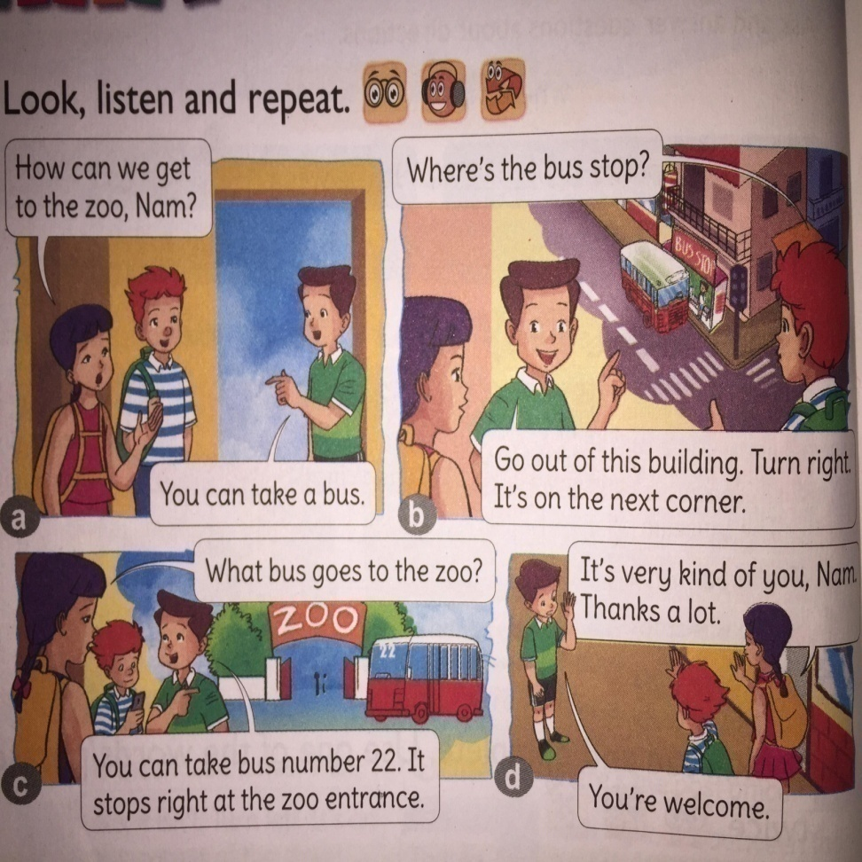
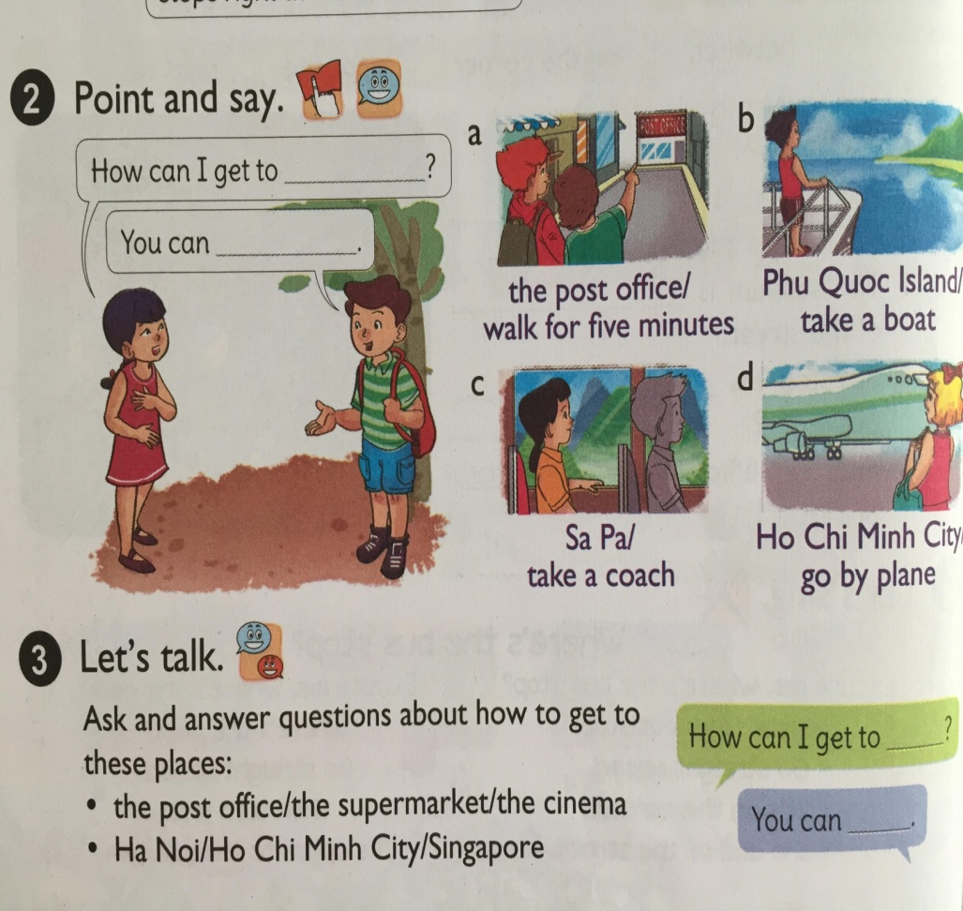
Thursday March 28th , 2019
English
Unit 16: Where’s the post office?
Lesson 2(1 , 2, 3)

Slide 4
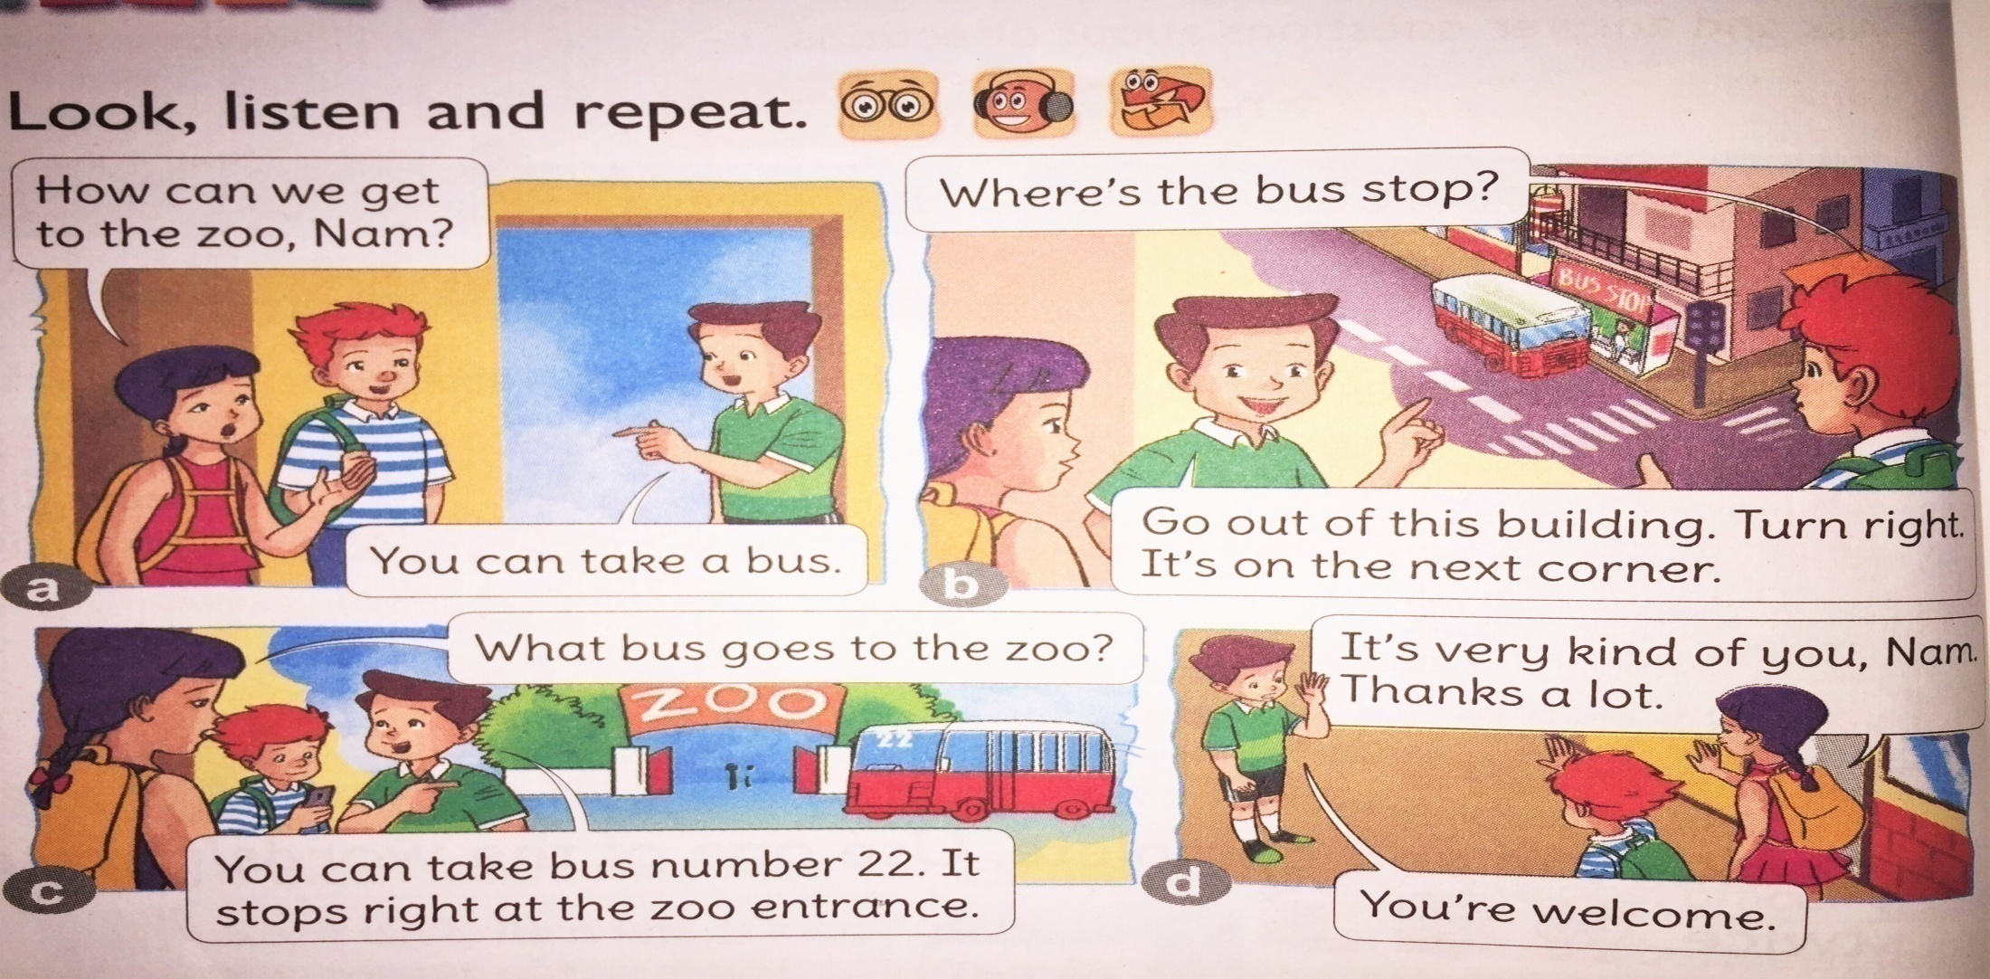
Thursday March 29th , 2018
English
Unit 16: Where’s the post office?
Lesson 2(1 , 2, 3)

Slide 5
Task
Listen the recording 2 times and repeat in choral.

Slide 6
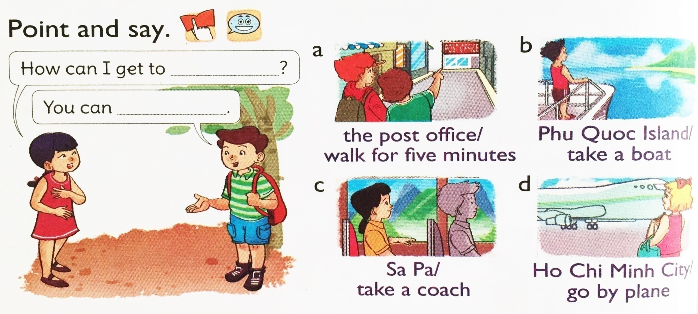
Thursday March 29th , 2018
English
Unit 16: Where’s the post office?
Lesson 2(1 , 2, 3)
2. Point and say
We’re going to practice asking/ answering Qs about
means of transport using following sentence pattern.

Slide 7
Game
WHAT AND WHERE

Slide 8
3. Let’s talk
Talk
Work in pairs. Ask, answer questions about directions, using:
Where’s the ...? It’s ...
Where’s the_________?
It’s_________.

Slide 10
Homework:
- Learn by heart new words.
- Do exercises in workbook.

